Slide 1


Green Pace
Security Policy Presentation
Developer: Robert Golden
Notes:
Hello today, my name is Robert Golden and I have been asked to go over the security policy for Green Pace. The actual security policy will be distributed, but I have prepared a PowerPoint with highlights over all the aspects of the policy.

Slide 2

OVERVIEW: DEFENSE IN DEPTH
Rather than leaving information security as an after thought, Green Pace is implementing security measures throughout the development process. Using a detailed set of policies and procedures creates layers of security surrounding sensitive information. Structuring and managing security in this manner is a best practice when using a defense in depth strategy.
Green Pace’s adopted security policy highlights
Outlines ten principals which shows the direction Green Pace has decided to take to increase information security.
Coding standards detailing how to mitigate identified threats while in development of code.
Suggested coding checkers to automate / identify other potential weaknesses in code.
Notes:
Defense in depth is the theme of this security policy. Rather than leaving information security as an after thought, Green Pace is implementing security measures throughout the development process. Using a detailed set of policies and procedures creates layers of security surrounding sensitive information. Structuring and managing security in this manner is a best practice when using a defense in depth strategy.
Green Pace’s adopted security policy highlights
Outlines ten principals which shows the direction Green Pace has decided to take to increase information security.
Coding standards detailing how to mitigate identified threats while in development of code.
Suggested coding checkers to automate / identify other potential weaknesses in code.

Slide 3
THREATS MATRIX
With every coding standard there are threats that have been identified. The standards are listed here in their associated category. The likely and unlikely categories are an indication of the frequency these threats likely to occur. Priority and low priority signify the magnitude of impact associated with each standard.
Likely STD-003-CLG STD-004-JAV STD-005-CPP STD-010-CLG | Priority STD-003-CLG STD-004-JAV STD-005-CPP STD-009-CPP STD-010-CLG
Low priority STD-007-CPP STD-006-CLG | Unlikely STD-006-CLG STD-001-CPP
Notes:
With every coding standard there are threats that have been identified. The standards are listed here in their associated category. The likely and unlikely categories are an indication of the frequency these threats likely to occur. Priority and low priority signify the magnitude of impact associated with each standard.

Slide 4
10 PRINCIPLES
Validate Input Data - STD-004-JAV
Heed compiler warnings
Architect and Design for Security Policies - STD-010-CLG, STD-009-CPP, STD-008-
Keep It Simple - STD-004-JAV
Default Deny
Adhere to the Principle of Least Privilege
Sanitize Data Sent to Other Systems - STD-007-CPP
Practice Defense in Depth
Use Effective Quality Assurance Techniques - STD-006-CLG, STD-001-CPP, STD-008-CPP
Adopt a Secure Coding Standard
Notes:
Here are the ten principals mentioned earlier. They are validate input data, heed compiler warnings, architect and design for security policies, keep it simple, default deny, adhere to the principle of least privilege, sanitize data sent to other systems, practice defense in depth, use effective quality assurance techniques, and adopt a secure coding standard. What you see beside the principals are the coding standards that directly relate with that particular principal.

Slide 5
CODING STANDARDS
High Priority
STD-010-CLG
STD-009-CPP
STD-005-CPP
STD-004-JAV
STD-003-CLG
Medium Priority
STD-001-CPP
STD-002-CPP
STD-008-CPP
Low Priority
STD-007-CPP
STD-006-CLG
Notes:
Here are the standards broken down in to priority groups. The three groups are High, Medium, and low. High priority are for standards that have a high impact and are highly probable of happening. Medium priority are standards that happen a lot and and have a low impact, or have a high impact and don’t have a big chance of happening. Low priority are the standards that don’t happen often and have a low level of impact.

Slide 6
ENCRYPTION POLICIES
Encryption in rest
Data being stored on any Green Pace asset will be encrypted.
Access will only be granted with authentication key
Encryption at Flight
Data will be encrypted before transmission.
Encryption in Use
While data is being handled or created, encryption should be applied.
Notes:
Encryption at rest is the protection of data while being stored on a variety of devices also including cloud storage locations. Green pace needs to ensure the safe keeping of their data. This is why they require the data to be encrypted when it is stored. Encryption at flight is the state of data as it is traveling between two points. While data is in this state encryption is needed so that only with the appropriate key would someone be able to read it. Encryption in use is the act of encrypting data while it is being created or handled.

Slide 7
TRIPLE-A POLICIES
Authentication
Access to the system will be granted upon successful verification of the user.
Typically with username and password
Some situations could require the use of a two factor authentication
Authorization
Standard default for profiles will be denied until changed by administrator.
Limiting access only to necessary parts of the system.
Limiting what information the user can see based on their role.
Accounting
Logs will be kept on user activity, what areas were accessed, and anything changed or transmitted.
Notes:
Triple A policies are authentication authorization and accounting. Authentication is only granting access upon a successful verification of the user. This is usually done with a username and password, but there are also other ways of ensuring a user is authenticated before granting access.
Authorization is the act of limiting access to certain elements of a system unless authorized. This is done by having the default profile setting to deny access to any parts of the system. Then only allowing access to essential or necessary parts of the system, or what information can be viewed.
Accounting is creating logs of the users activity which includes what modules were accessed and anything created, changed, or transmitted.

Slide 8
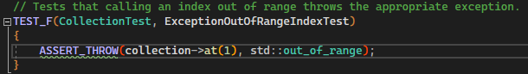

Exception Thrown
Testing that out-of-range index calls throw an exception.
This was done on an empty collection. Taking it furthers would be calling an out-of-range index on a populated collection.
Notes:
Unit testing is a software testing technique where individual units or components of a software application are tested in isolation from the rest of the application. The next few slides including this one are some examples of this.
This slide shows how testing was done to ensure that when an index that was out of range is called that an exception was thrown. This could have also been done with a populated collection to test even further.

Slide 9
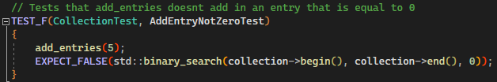

Entry Added Not Zero
Adding entries and testing that they aren’t equal to zero
Taking this further could be testing that entries weren’t over one hundred.
Notes:
This test ensures that the entry that has been added to the collection is not equal to zero.

Slide 10
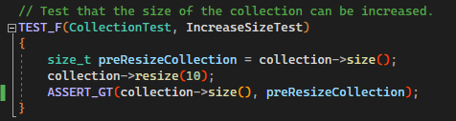

Increased Size
Testing that the collection can be resized.
Use of the Assert Greater than method we compared the current size to previous.
Testing multiple resize or also testing a decrease in size would be taking it a step further.
Notes:
The increased size test is testing that collection size does increase when a resize is performed. This could have also been done by verifying that it works by reducing the size.

Slide 11
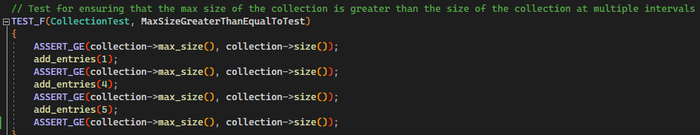

Max Size
Verifying with the assert greater than method that max size is greater than size.
Could be taken further removing entries and testing again.
Notes:
This slide shows us the max size unit test. Shown to us in the screenshot to the right we see use of the assert greater than method that is checking that the max size is greater than the size of the collection. This is done at multiple sizes, but this could also have been tested by decreasing the size of the collection to make sure it is behaving as intended.

Slide 12

AUTOMATION SUMMARY
Notes:
Depicted is the flow of development security operations. Automation is riddled throughout every part in some way. The use of code checkers while building compiling and testing would be in the build / verify and test portions.

Slide 13
TOOLS
The DevSecOps pipeline is a series of stages that integrates security into every stage of the development process.
CPPCheck – Static analyzer, but also offers integration in to some IDE’s.
Parasoft – IDE integration that makes testing easier on the developer.
Googletest – test fixture used for results validation.
Notes:
The DevSecOps pipeline is a series of stages that integrates security into every stage of the development process.
CPPCheck – Static analyzer, but also offers integration in to some IDE’s.
Parasoft – IDE integration that makes testing easier on the developer.
Googletest – test fixture used for results validation.

Slide 14
RISKS AND BENEFITS
Waiting to implement security.
Increased vulnerability to security threats and breaches
Breaches in security can be costly after they occur
Exposure to legal action after security breach
Implementing now
Immediate protection against known vulnerabilities and threats
Less chance of incidents and the cost associated.
Increased customer trust
More layers / depth of defense built in to mitigate attacks.
Notes:
Waiting to implement security.
Increased vulnerability to security threats and breaches
Breaches in security can be costly after they occur
Exposure to legal action after security breach
Implementing now
Immediate protection against known vulnerabilities and threats
Less chance of incidents and the cost associated.
Increased customer trust
More layers / depth of defense built in to mitigate attacks.

Slide 15
RECOMMENDATIONS
Regularly review the security policies and update when necessary
Ensure third party automation is current
Ensure that polices are followed
More testing to ensure that code does what it is designed to.
Notes:
Regularly review the security policies and update when necessary
Ensure third party automation is current
Ensure that polices are followed
More testing to ensure that code does what it is designed to.

Slide 16
CONCLUSIONS
Practice Defense in depth
Continue to perform unit testing
Follow principals, procedures, and standards.
Notes:
Practice Defense in depth
Continue to perform unit testing
Follow principals, procedures, and standards.

